Slide 1

Tom and Jerry (A JavaScript Game)
Presented by Nishtha
Student ID: 10013202722
Course: CSE2
Date: Monday- 04,Nov,2024

Slide 2
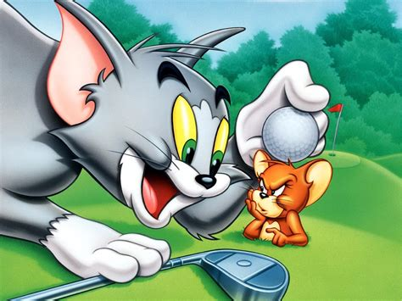
Introduction
The primary objective of this project is to create an engaging and interactive web-based game inspired by the classic cartoon characters Tom and Jerry. The game aims to provide an enjoyable user experience while showcasing fundamental web development skills through the use of HTML, CSS, and JavaScript.

Slide 3
Objectives
• Developing an engaging game using HTML, CSS, and JavaScript.
• Implementing character controls, animations, and score tracking.
• Providing a fun user experience with increasing game difficulty.

Slide 4
Technology Stack
• HTML for structure
• CSS for styling and animations
• JavaScript for game logic and functionality

Slide 5
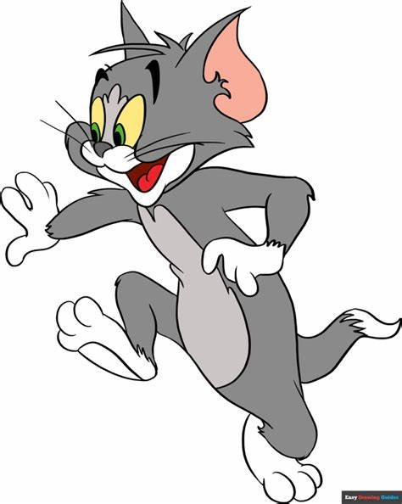
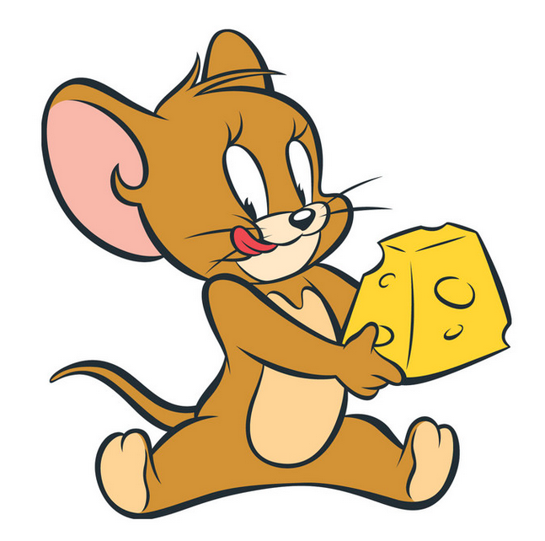
Game Features
• Character movements with keyboard controls.
• Collision detection between Tom and Jerry.
• Score tracking that updates as the game progresses.
• Increasing difficulty with Tom’s speed.

Slide 6
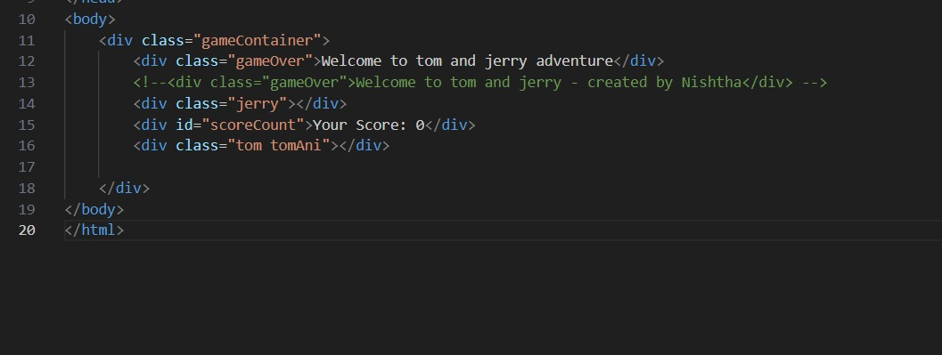
Technical Implementation - HTML
• Basic structure using HTML:
- Div containers for characters and score.
• Example code snippet of HTML structure.

Slide 7
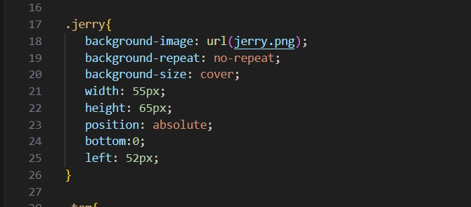
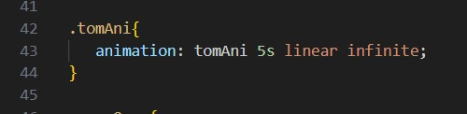
Technical Implementation - CSS
• CSS for styling characters and background.
• Adding animations for character movements.
• Example CSS code for animations.

Slide 8
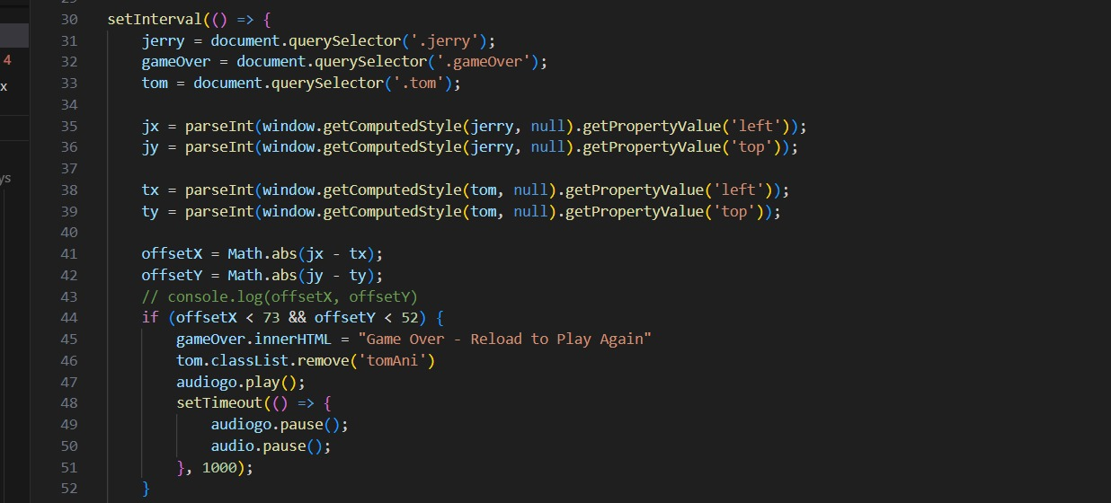
Technical Implementation - JavaScript
• Key functionalities:
- Event listeners for keyboard controls.
- Collision detection logic.
- Score updating function.
• Example JavaScript code for event handling.

Slide 9
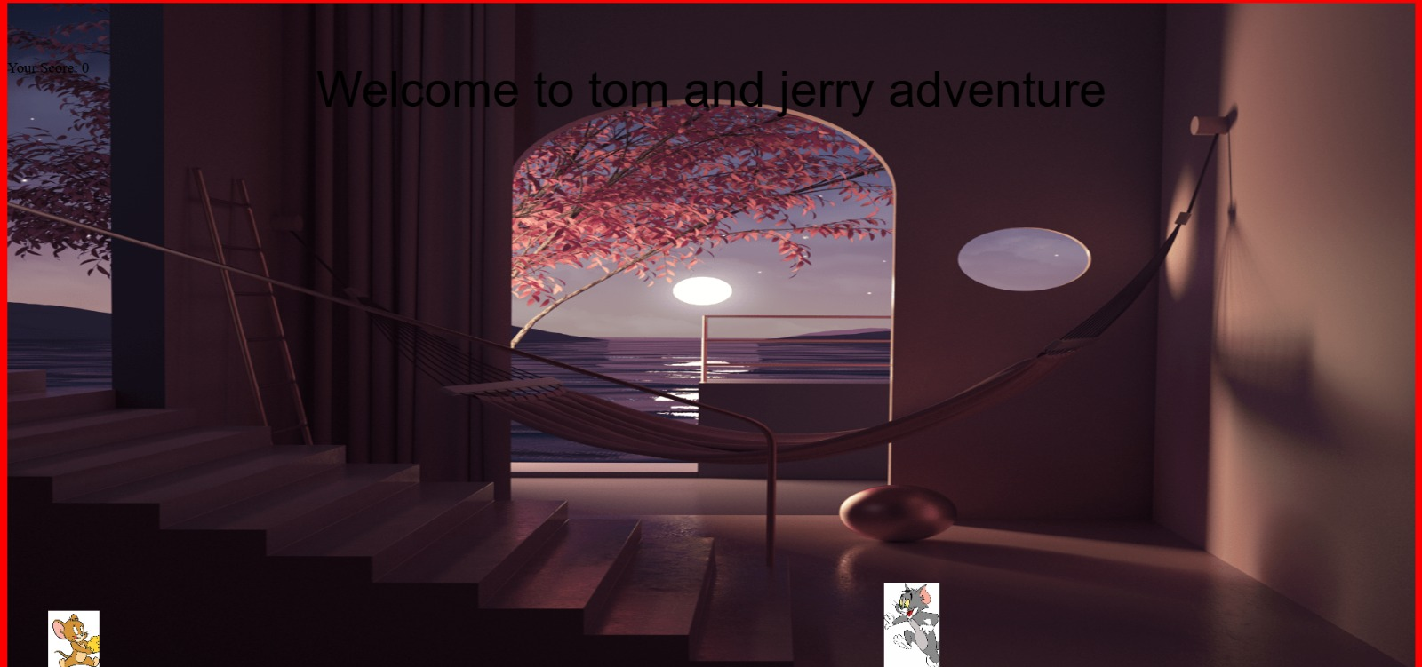
Game screening ( at the Beginning )

Slide 10
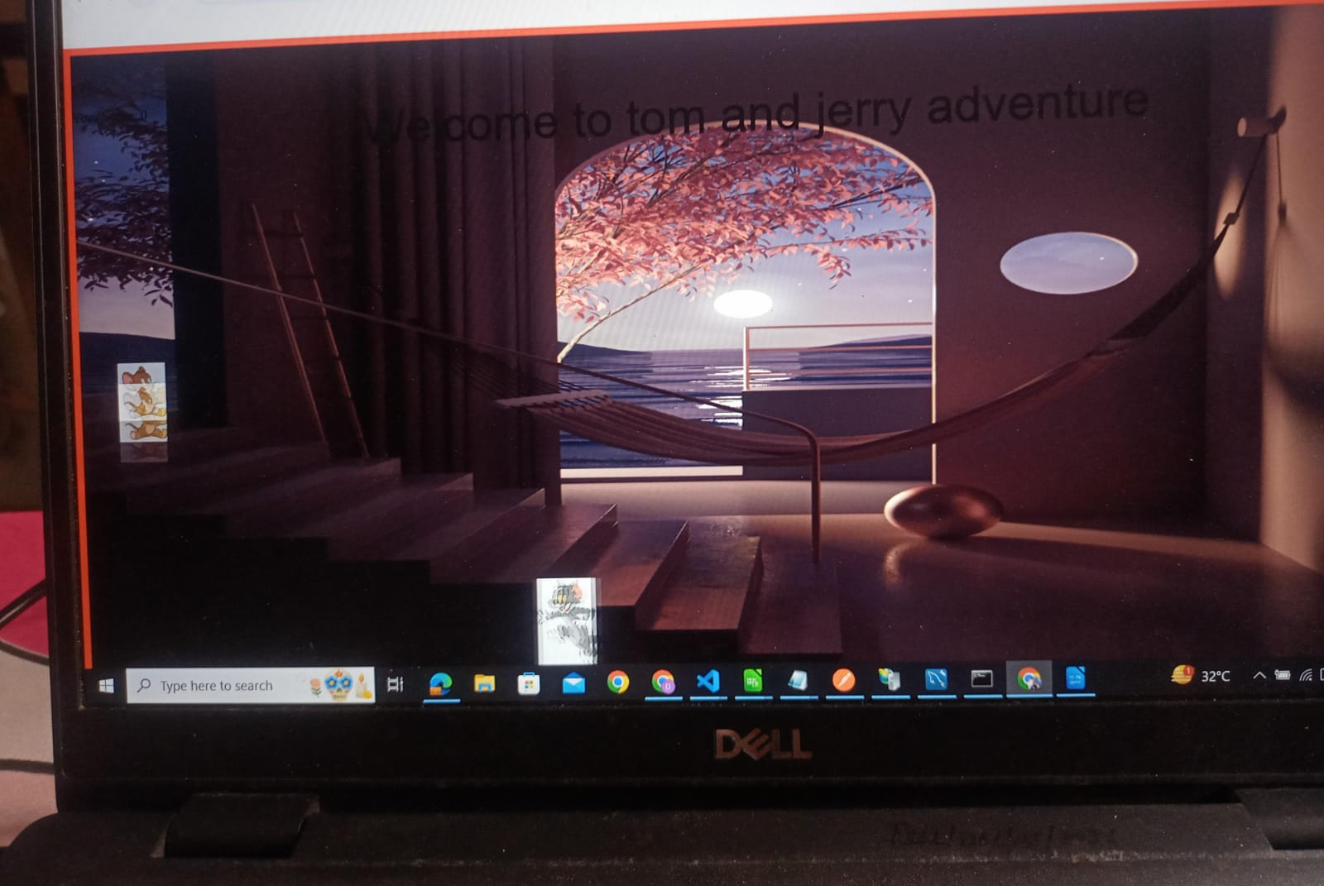
Game screening ( during the game play)

Slide 11
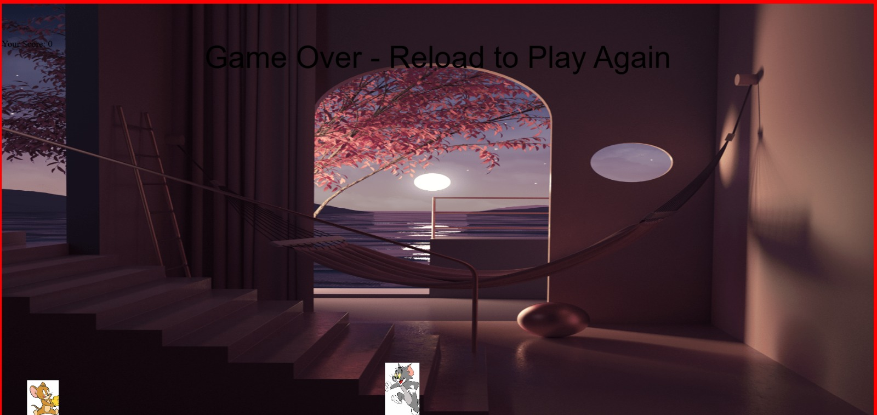
Game screening ( at the end )

Slide 12
Challenges and Solutions
• Key challenges faced:
- Implementing collision detection accurately.
- Adjusting animation speed dynamically.
• Solutions for each challenge.

Slide 13
Results and Conclusion
• Successful implementation of game mechanics.
• Interactive experience achieved through character control and animations.
• Learning outcomes in web development and JavaScript skills.

Slide 14
Future Scope
• Potential enhancements:
- Adding levels or power-ups.
-Improving graphics and sound.
-Making the game mobile – friendly.

Slide 15
Acknowledgments
• Thank you to:
- Mrs. Amanpreet kaur Ma’am
- Friends and classmates
- Family for support.

Slide 16
Q&A
Questions? Please feel free to ask.

